Slide 1
ECE 558 Final Project
Ram Bhattarai
Ryan Bentz
Speech Driven Light Show

Slide 2
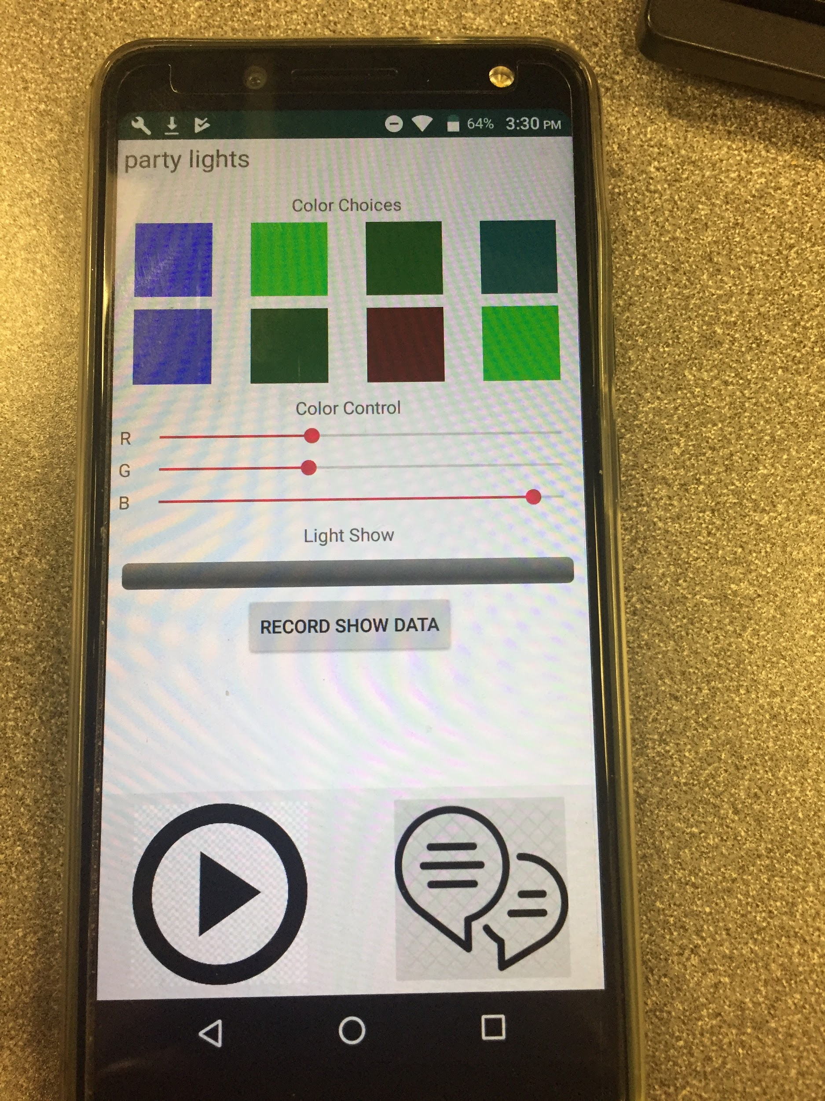
Overview
Say a word and It adds the word to the recyclerview.
Select the word you just said and create your own light show
Play the light show to see the light effects.
OR
Click on the predefined words and select the colors to do the Lightshow

Slide 3
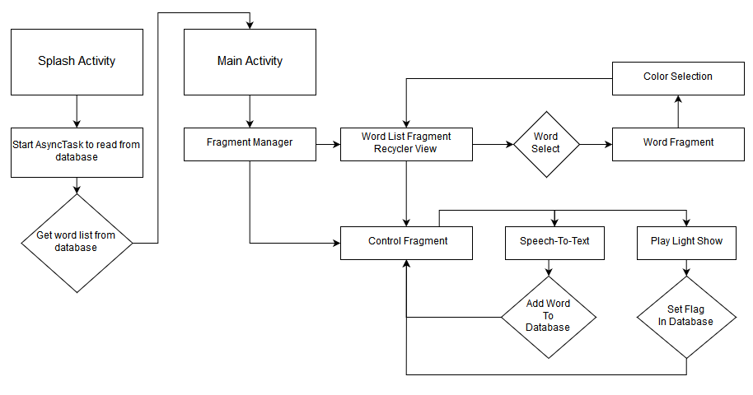
Implementation

Slide 4
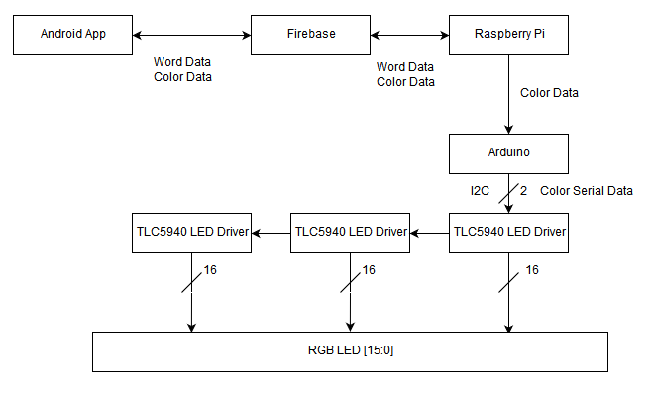
Architecture

Slide 5
Software
Recycler View holds the list of predefined words
Speech-to-Text adds new words to RecyclerView and database
AsyncTask manages database reading during splash screen
Firebase Database to stores word and light show data
Dynamic fragment based application architecture for mobile application
AndroidThings app handles LED color processing for low-level devices

Slide 6
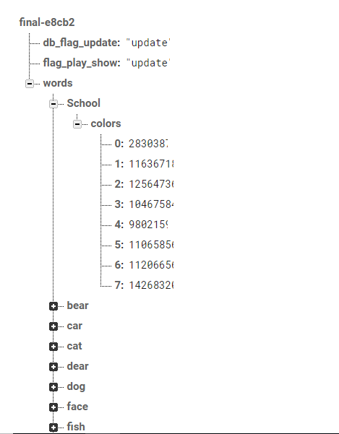
Database Structure

Slide 7
Challenges Faced
Creating the low-level driver for the LED Driver and interfacing with Arduino
Creating a decent lightshow given the chosen hardware design
Synchronizing information and events across fragments
Reading and writing to the database when the members are complex structures

Slide 8
Future Improvements
LED Matrix and Color Data Blending
Full speech recognition software that acts similar like siri but sends a commands to a device to produce a lightshow
Switching to individual addressable LED as Professor Roy suggested.

Slide 9
Thank You

